Slide 1
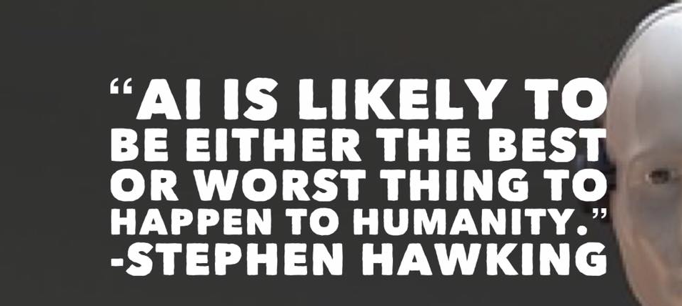

Slide 2
Agenda
Intro to Data Science
Importance of Data Visualization
Machine Learning Models
Choosing and Refining Models
Evaluation
Deep Learning and Its Usage
Tensorflow

Slide 3

SOPHIA : The AI masterpiece
Notes:
<iframe width="1280" height="720" src="https://www.youtube.com/embed/jWlzeV8_hEU" frameborder="0" allow="accelerometer; autoplay; encrypted-media; gyroscope; picture-in-picture" allowfullscreen></iframe>
https://www.youtube.com/watch?v=jWlzeV8_hEU

Slide 4
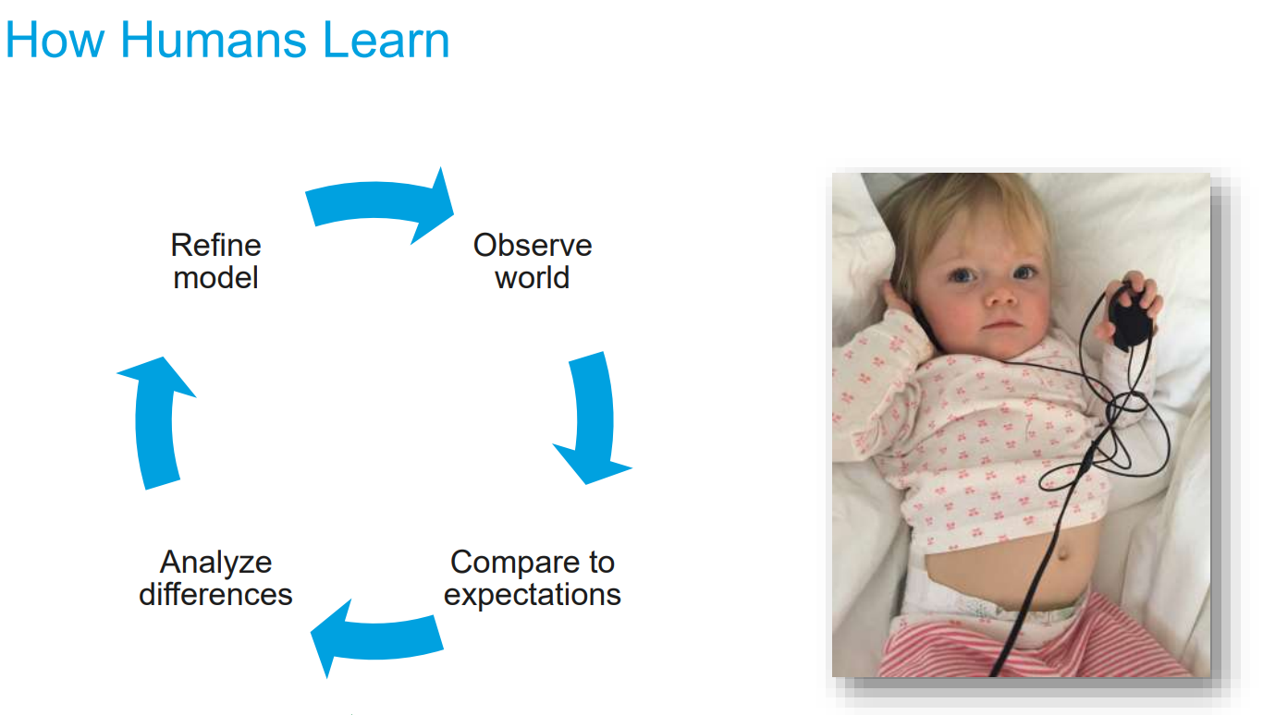

Slide 5
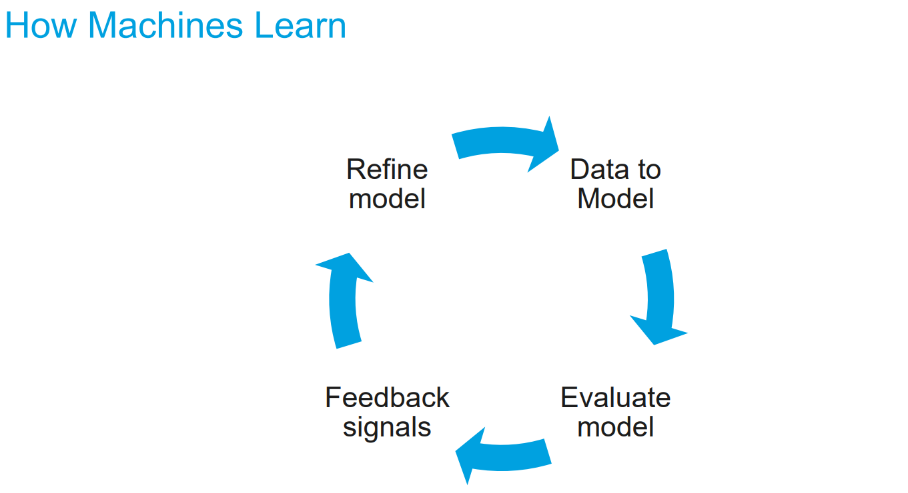

Slide 6
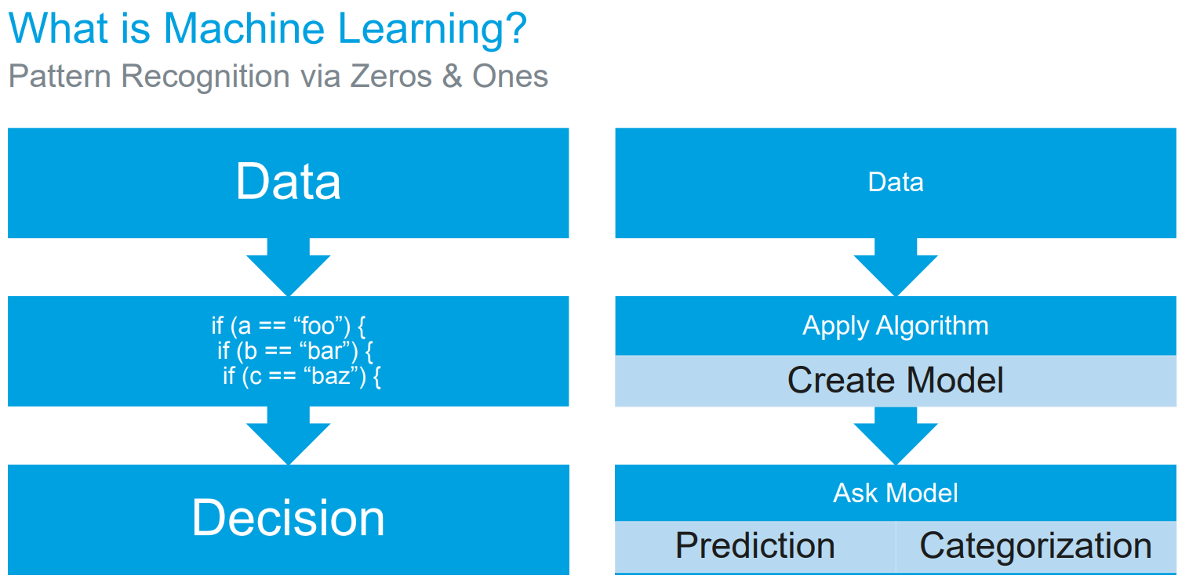

Slide 7



Understanding AI,ML and DL
Artificial Intelligence
Machine
Learning
Deep
Learning
Notes:
AI is techniques that enables computers to mimic human intelligence which includes voice and speech recognition, intent recognition, natural language understanding, pattern recognition etc.
Machine Learning is subset of AI which includes usage of statistical techniques that enables machine to learn and improve from experience. This is achieved by training algorithms on historical data (imparting experience) and using them to make predictions/forecast which further supports decision-making
Deep Learning is subset of machine learning concerned with algorithms inspired by the structure and function of the brain called multi-layered artificial neural network. They perform task like speech and image recognition by exposing ANNs to vast amount of data.

Slide 8
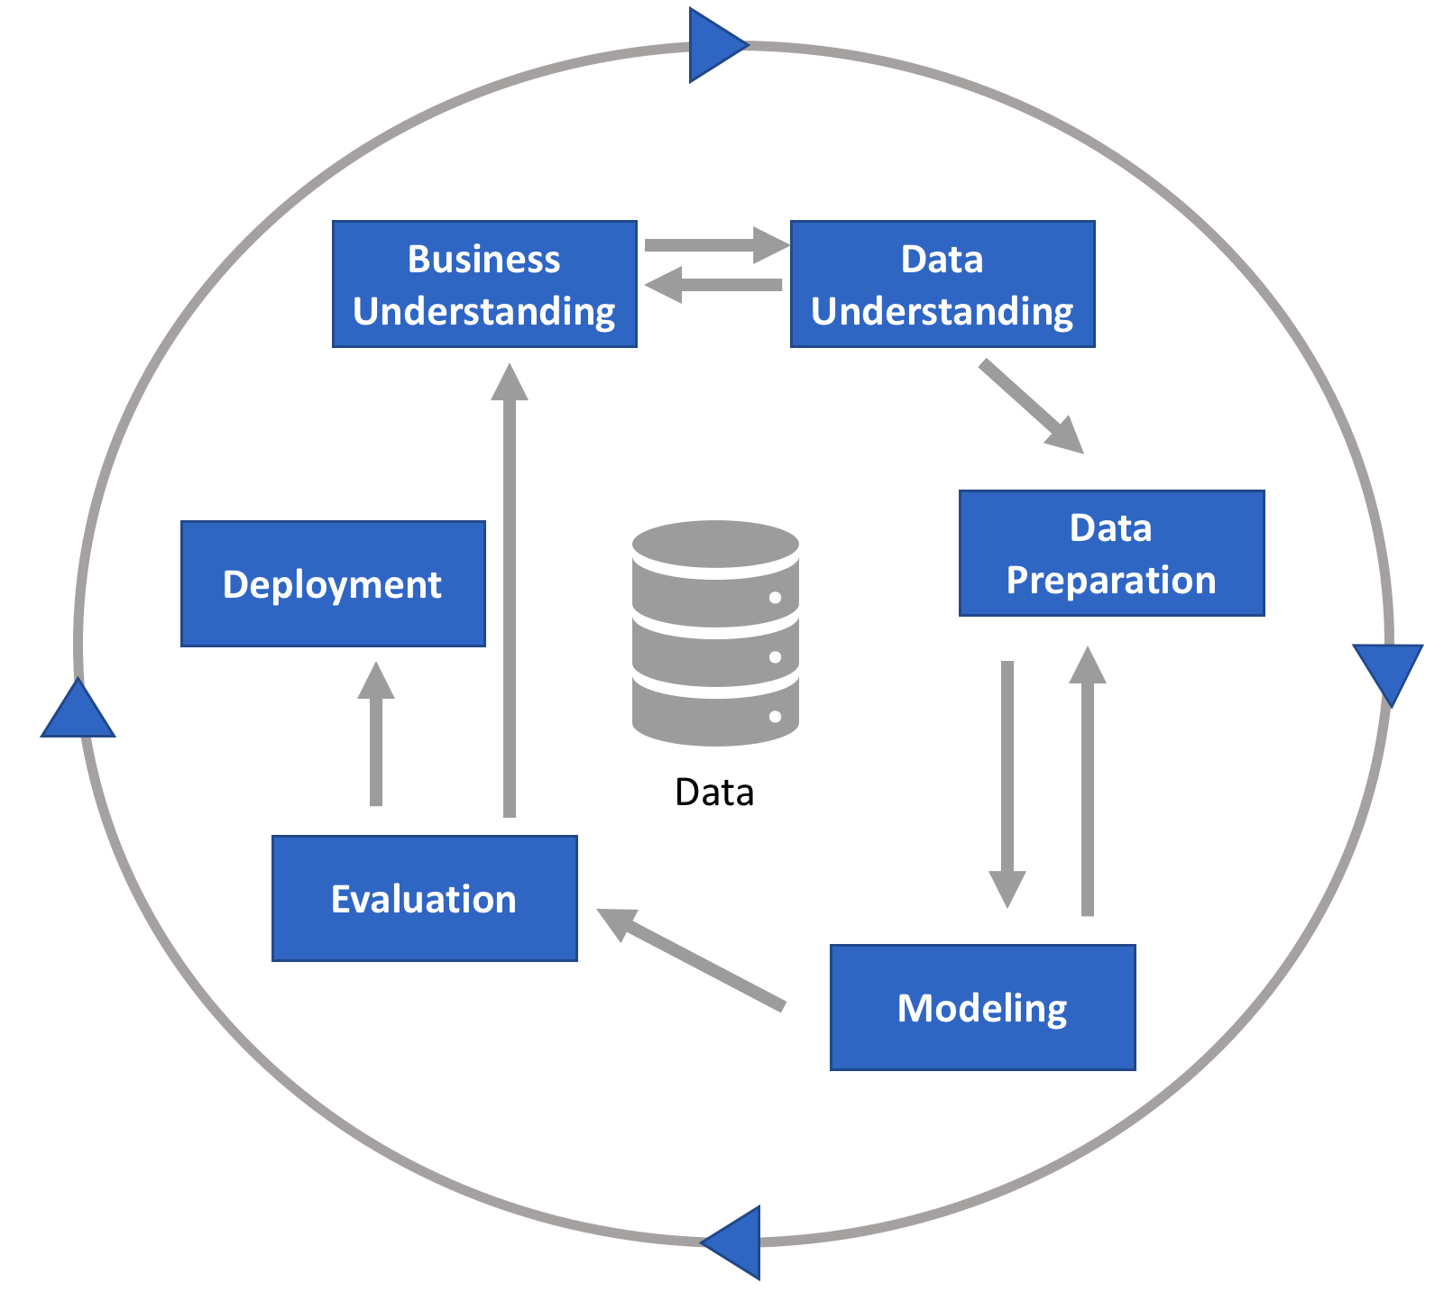
Cross Industry Standard Process of Data Mining

Slide 9
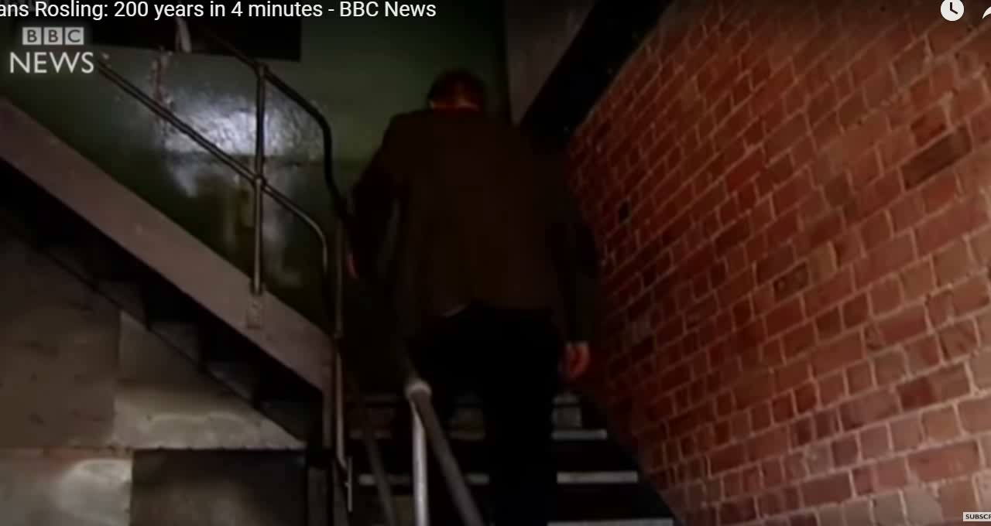
Data Visualization 200 years of World in 4 mins

Slide 10
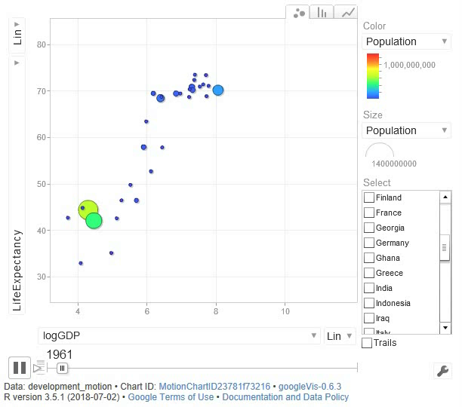
Data Visualization Sample

Slide 11
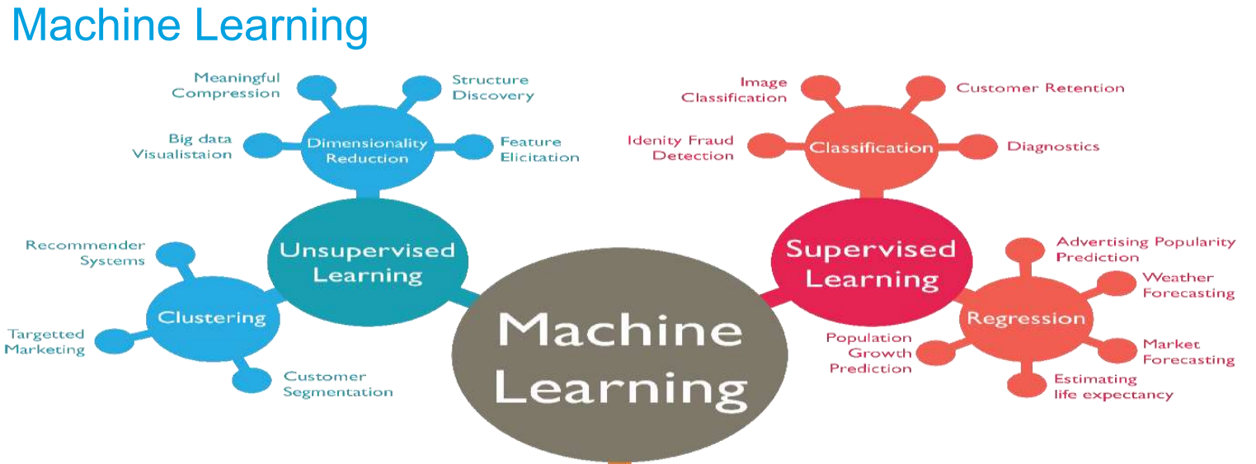
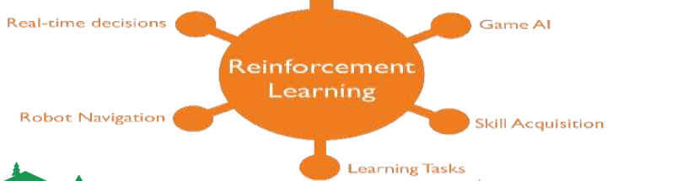

Slide 12
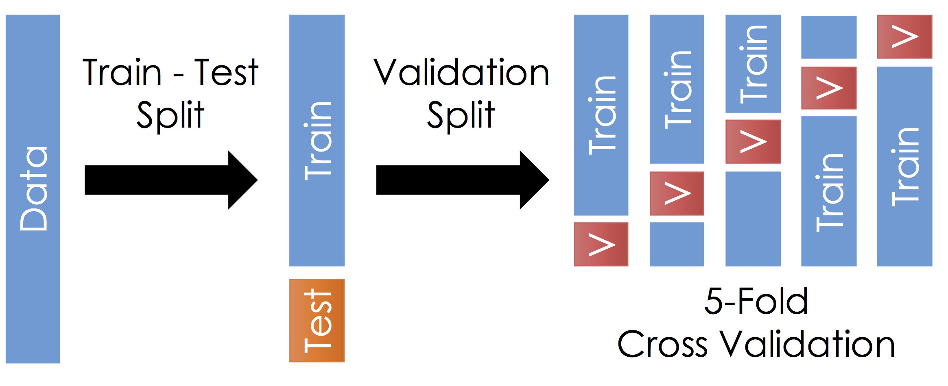
Model Development and Validation

Slide 13
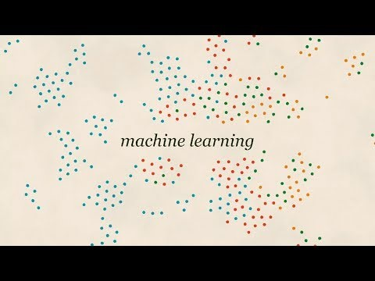
Notes:
https://www.youtube.com/watch?v=59bMh59JQDo
<iframe width="1280" height="720" src="https://www.youtube.com/embed/59bMh59JQDo" frameborder="0" allow="accelerometer; autoplay; encrypted-media; gyroscope; picture-in-picture" allowfullscreen></iframe>

Slide 14
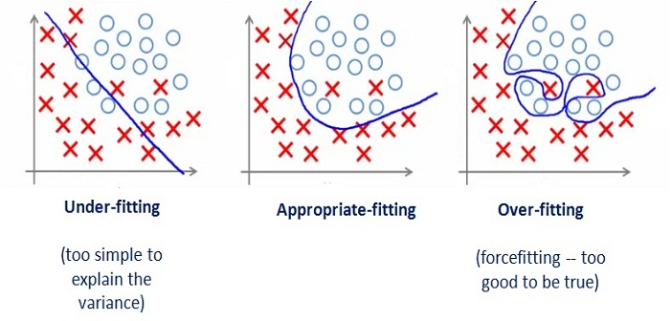
Under fit- Balanced- Over fit

Slide 15
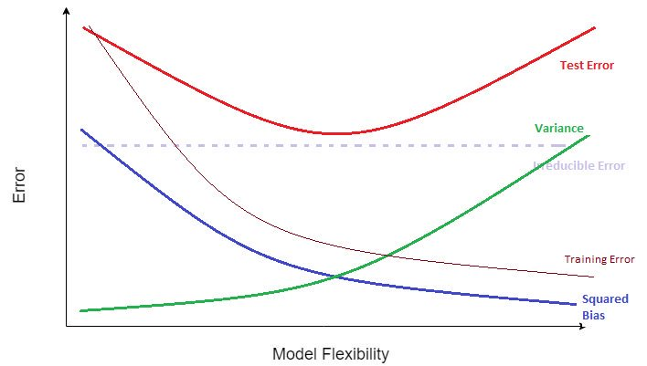
Bias – Variance Trade-off

Slide 16
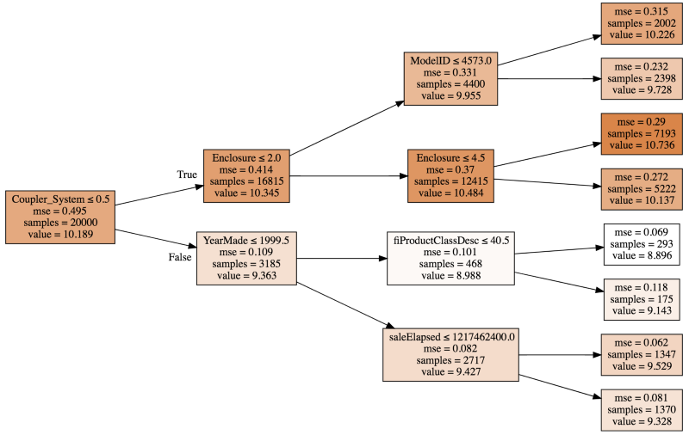
Model

Slide 17
Evaluation
Squared Error
Accuracy
Precision & Recall
Entropy
F Score

Slide 18
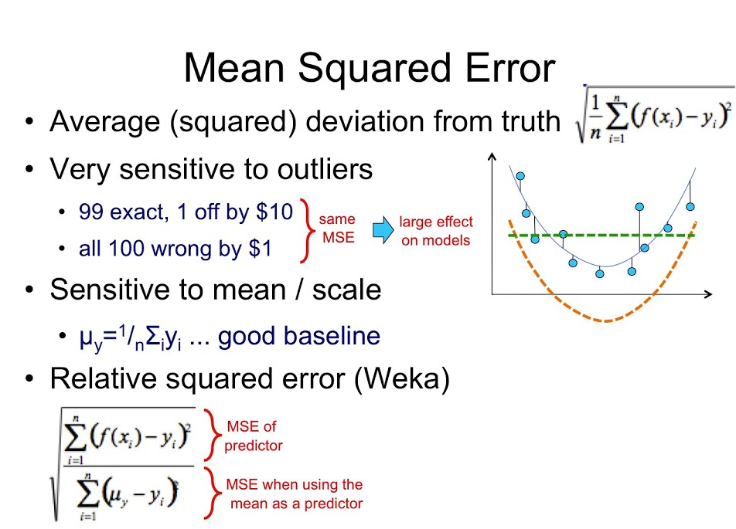
Squared Error

Slide 19
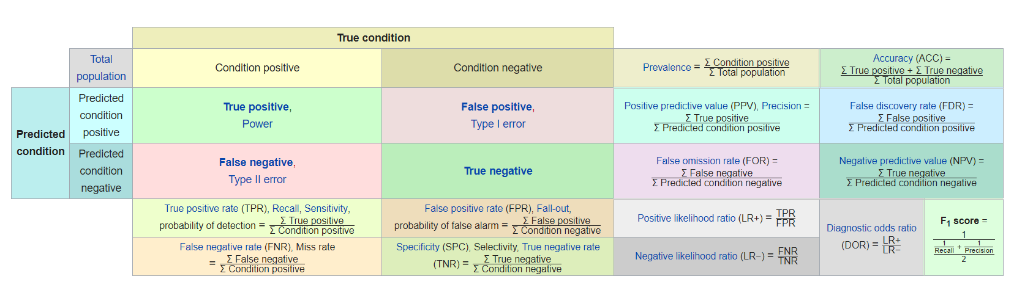
Accuracy, Precision, Recall, F Scores

Slide 20
Applications
Insurance
Claims prediction
Claims handling
Price sensitivity
Investments
Agent & branch performance
DM, product mix
Construction
Contractor performance
Design issue prediction
Life Sciences
Identifying biomarkers
Identifying negative responses
Diagnostic test development
Diagnostic targeting
Predicting drug demand
Prescription adherence
Putative safety signals
Social media marketing
Image analysis
Clinical trial design
COGS optimization
Hospitality
Dynamic pricing
Promos/upgrades/offers
Table management & reservations
Workforce management
Manufacturing
Failure analysis
Quality management
Inventory management
Warranty/pricing
Agriculture
Yield management
Automation
Mall Operators
Tenant capacity to pay
Tenant selection
Education
Automated essay scoring
Dynamic courses
Utilities
Optimize Distribution Network
Predict Commodity Requirements
Direct Marketing
Response rates
Segmentations for mailings
Reactivation likelihood
RFM
Discount targeting
Phone marketing
Email Marketing
Drug/chemical discovery
Analyzing study results

Slide 21

Object Classification

Slide 22
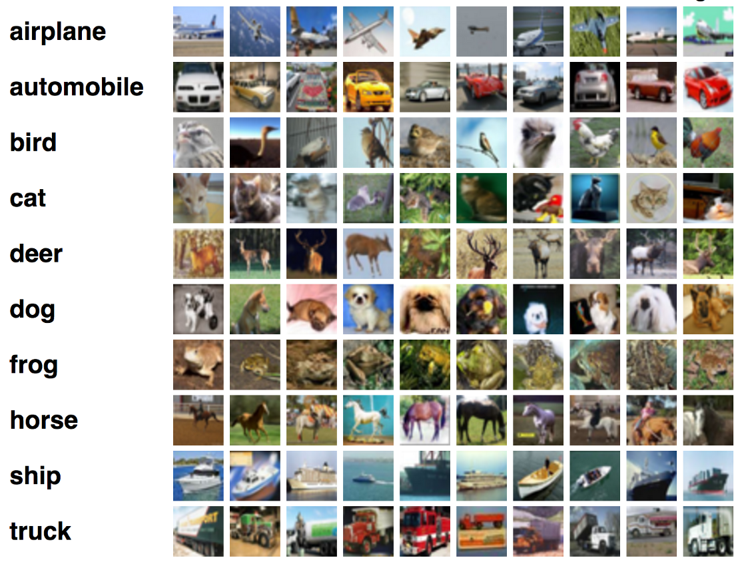
Object Classification

Slide 23
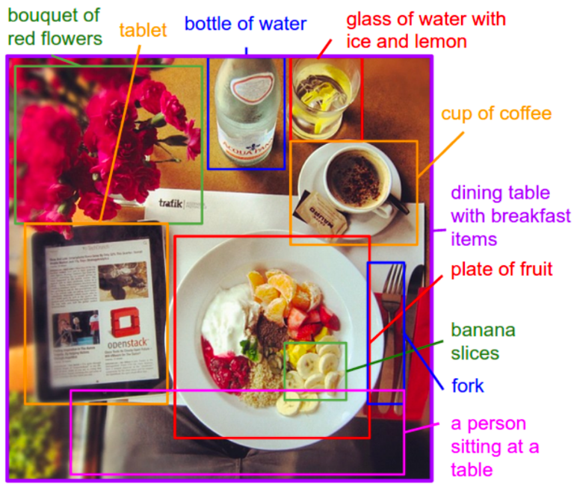
Object Detection

Slide 24
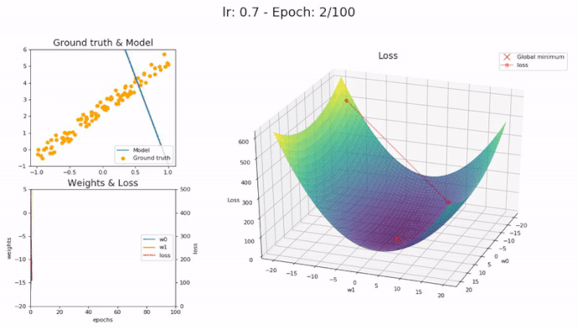
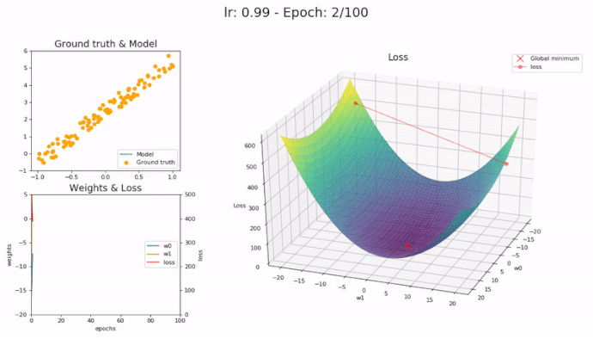
Gradient Descent

Slide 25

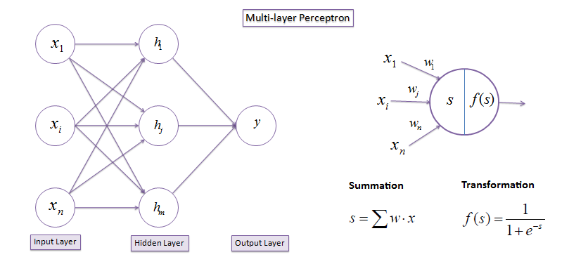
Notes:
Input / Output
Activations
Cost/Loss Function
Optimization (SGD)
Back Propagation
Learning Rate

Slide 26
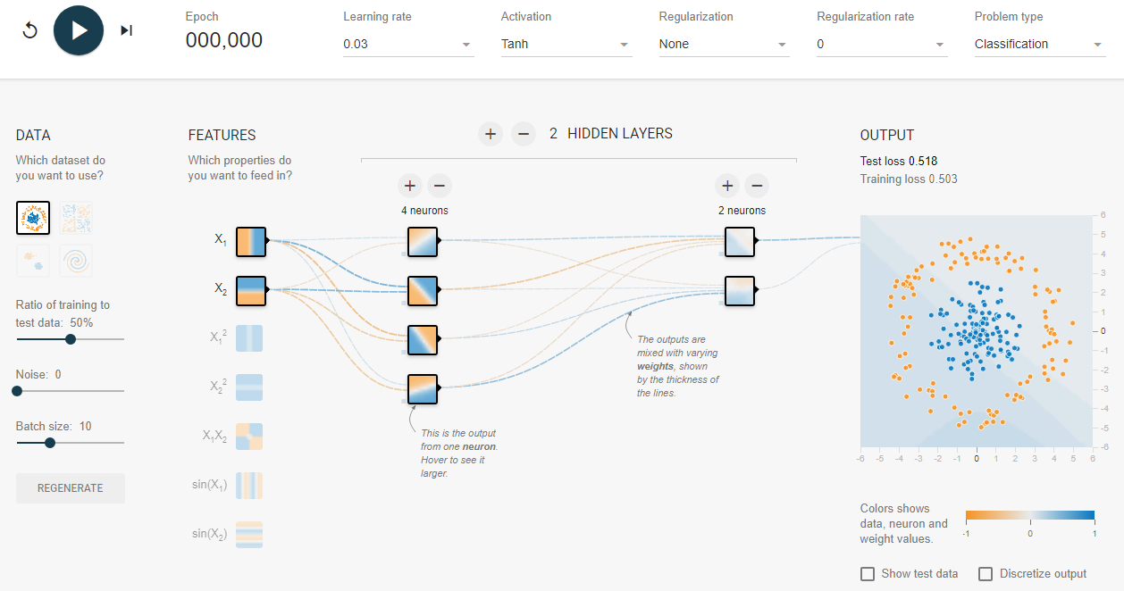
https://playground.tensorflow.org

Slide 27
Q & A

